Slide 1
Dataset and Studies about Hand Gesture
https://paperswithcode.com/task/hand-gesture-recognition

Slide 2
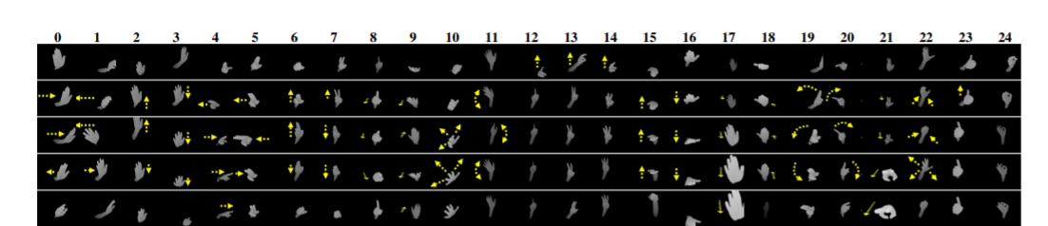
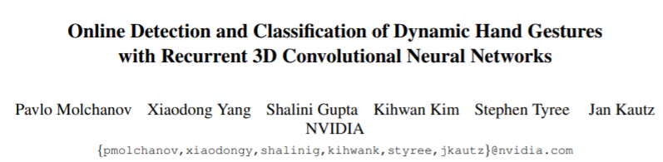
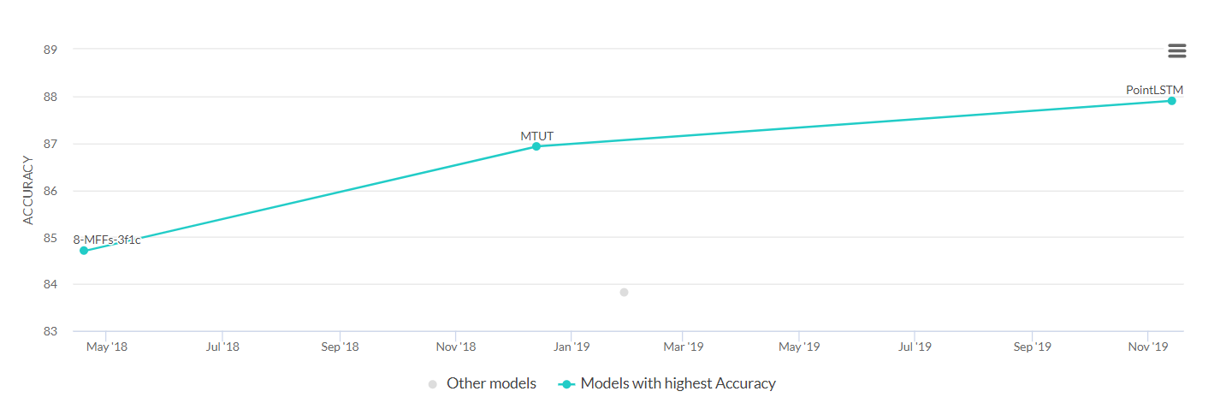
NVGesture
Info | Value
Dynamic | Yes
Environment | Indoors in car simulator
Device | SoftKinetic depth camera
N | 1532
Class | 25
N train | 1050
N test | 482
Length | 5s
Subjects | 20 people
https://docs.google.com/forms/d/e/1FAIpQLSc7ZcohjasKVwKszhISAH7DHWi8ElounQd1oZwORkSFzrdKbg/viewform

Slide 3
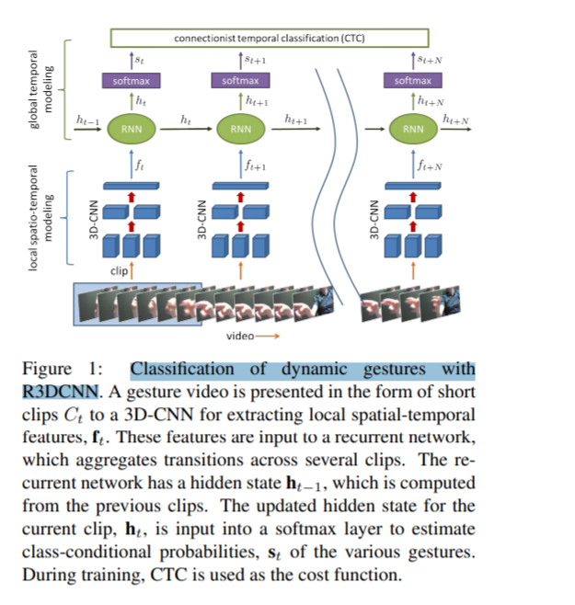
Online Detection and Classification of Dynamic Hand Gestures with Recurrent 3D Convolutional Neural Networks
The architecture consists of a deep 3D-CNN for spatio-temporal feature extraction,
a recurrent layer for global temporal modeling,
and a softmax layer for predicting class-conditional gesture probabilities
We perform classification by splitting the entire video V into T clips of length m and computing the set of classconditional probabilities S = {s0, s1, ..., sT −1} for each individual clip. For offline gesture classification, we average the probabilities of all the clips belonging to a presegmented g

Slide 4
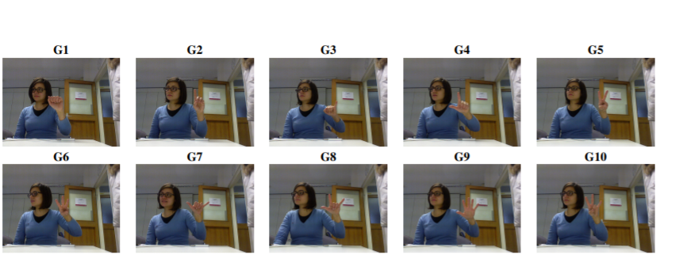
University of Padova
https://lttm.dei.unipd.it/downloads/gesture/
Info | Value
Dynamic | No (depth map)
Environment
device | Kinect
N | 1400
Class | 10
N train
N test
Length
Subjects | 14 people

Slide 5
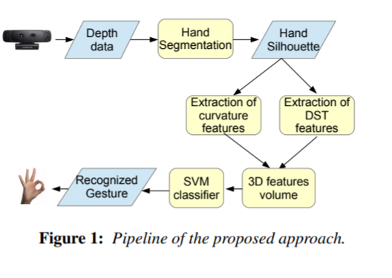
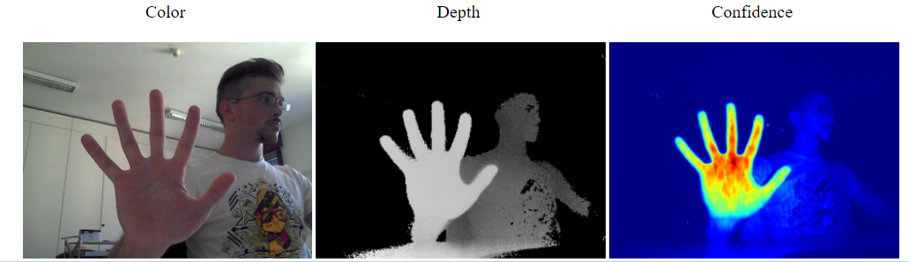
Creative Senz3D
Exploiting Silhouette Descriptors and Synthetic Data for Hand Gesture Recognition
Info | Value
Dynamic | No (depth map)
Environment
device | Creative Senz3D camera
N | 1320
Class | 11
N train
N test
Length
Subjects | 4 people

Slide 6
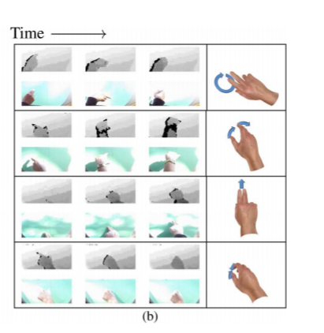
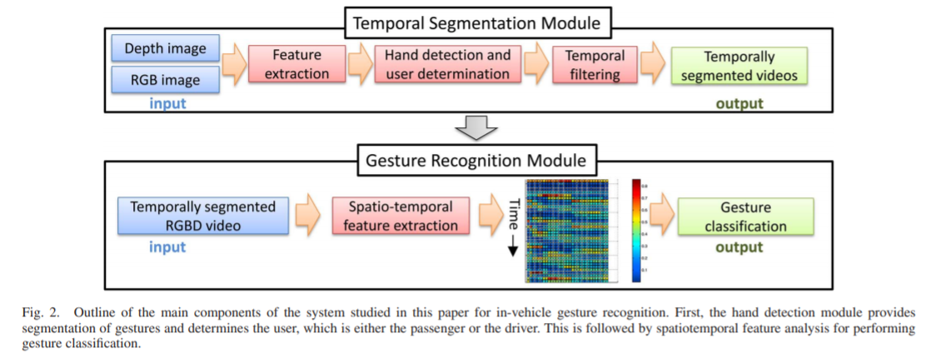
CVRR-HANDS 3D Dataset
http://cvrr.ucsd.edu/LISA/hand.html
Info | Value
Dynamic | yes
Type | Videos, image (depth, RGB)
Environment | incar
device | Creative Senz3D camera
N | 886
Class | 19
N train
N test
Length
Subjects | 8 people

Slide 7
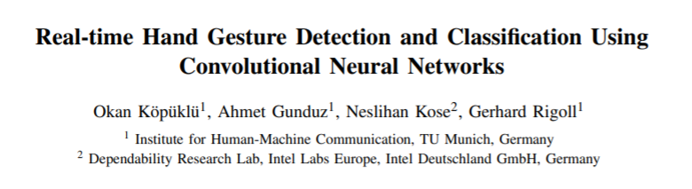
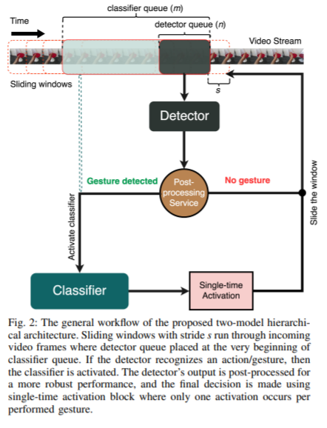
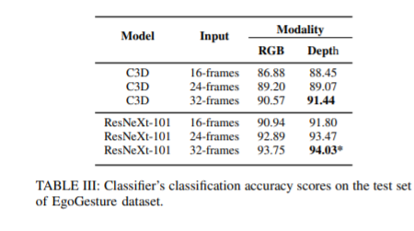
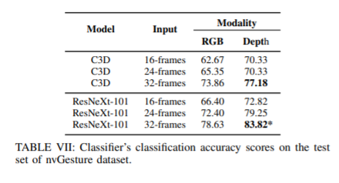
https://paperswithcode.com/paper/real-time-hand-gesture-detection-and
Step1: we do not know when a gesture starts or ends. starts with a detector which is used as a switch to activate classifier if a gesture gets detected
Step2: Classifer
Model: 3D CNN based ResNet

Slide 8
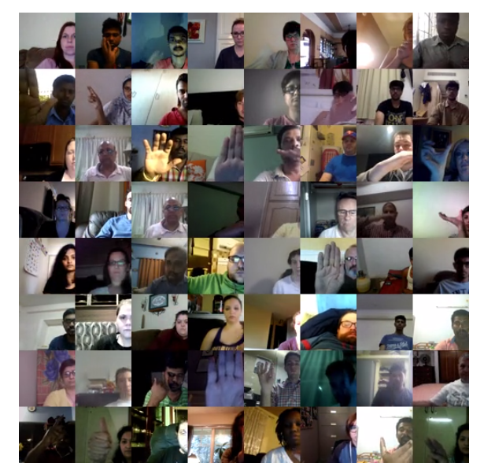
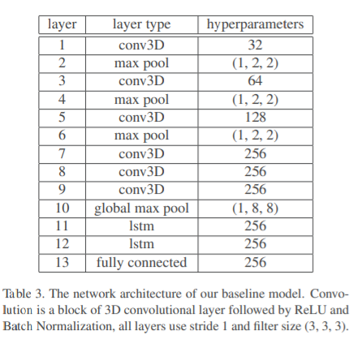
The 20BN-jester Dataset V1 * (Biggest dataset) https://20bn.com/datasets/jester
Info | Value
Type | Videos, image (depth, RGB)
Environment | vary
device
N | 148092 videos
Class | 27
N train | 118562
N test | 14743
Length | 3 seconds
Subjects | 1376 people
Baseline model:
3D CNN: 93.87%

Slide 9
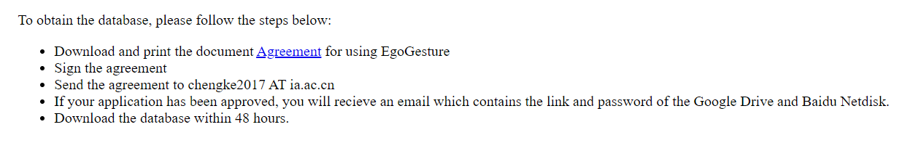
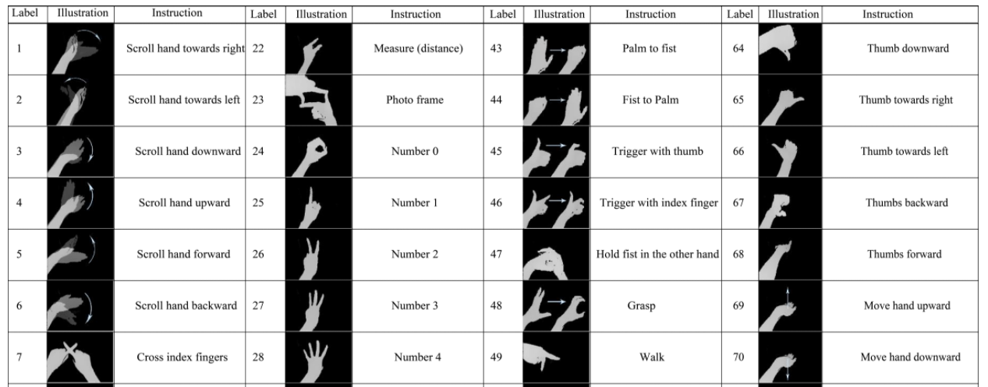
EgoGesture
http://www.nlpr.ia.ac.cn/iva/yfzhang/datasets/egogesture.html
Info | Value
Type | Videos, image (depth, RGB)
Environment | 4 indoors, 2 outdoors
device | egocentric camera
N | 2081 videos (24,161 gesture)
Class | 83
N train | 14416/4768
N test | 4977
Length
Subjects | 50 people

Slide 10
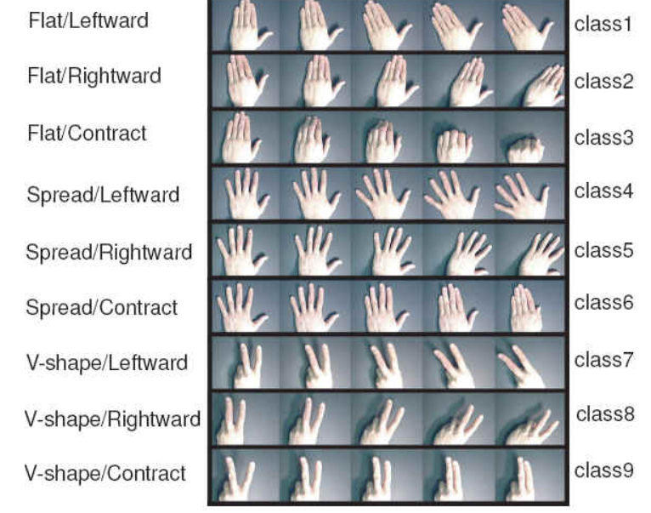
Cambridge Hand Gesture Data set
https://labicvl.github.io/ges_db.htm
Info | Value
Type | image (RGB)
Environment | indoor
device
N | 900
Class | 9
N train
N test
Length
Subjects

Slide 11
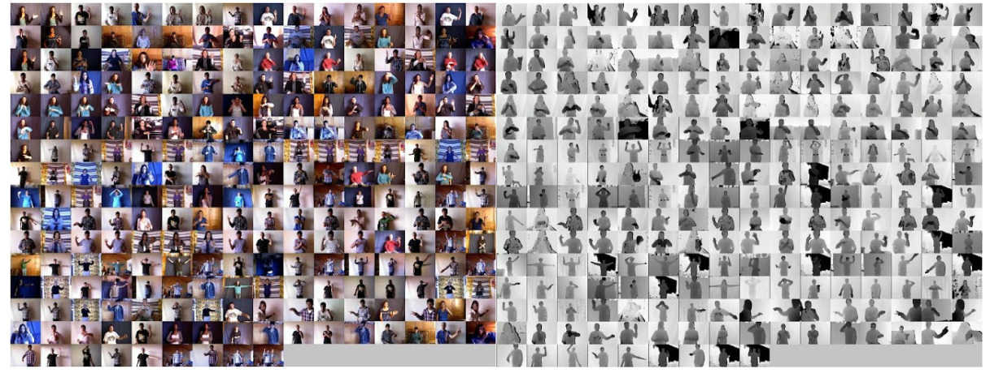
ChaLearn Gesture Dataset (CGD 2011)
https://gesture.chalearn.org/data
https://gesture.chalearn.org/2016-looking-at-people-cvpr-challenge/isogd-and-congd-datasets
Info | Value
Type | Videos (RGD, depth)
Environment | varies
device
N | 47933
Class | 249
N train/N val | 35878/5784
N test | 6271
Length | 4s
Subjects | 21

Slide 12
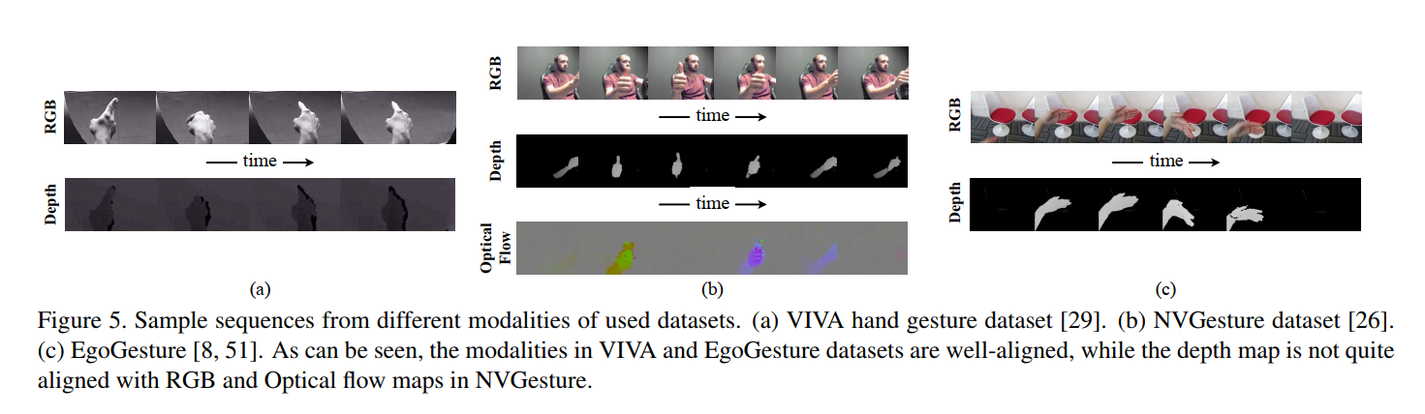
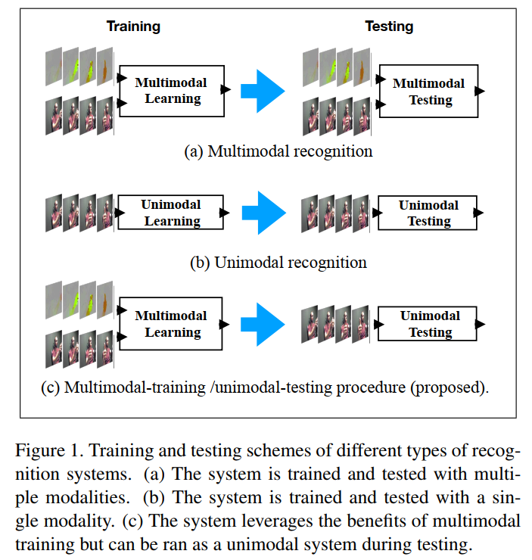
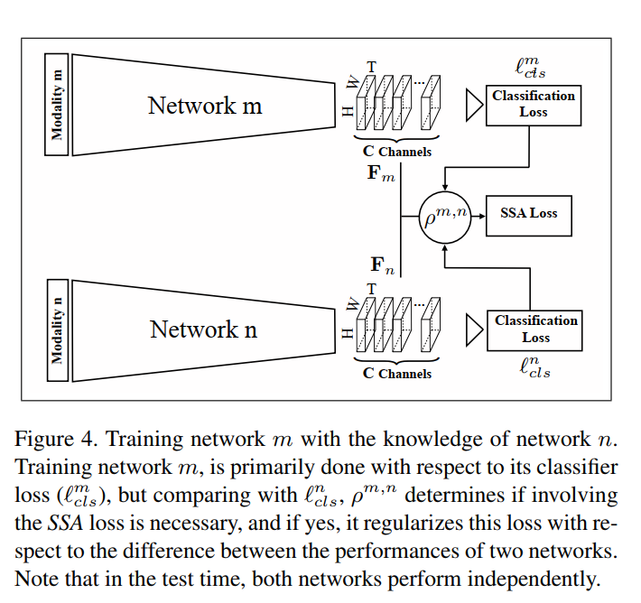
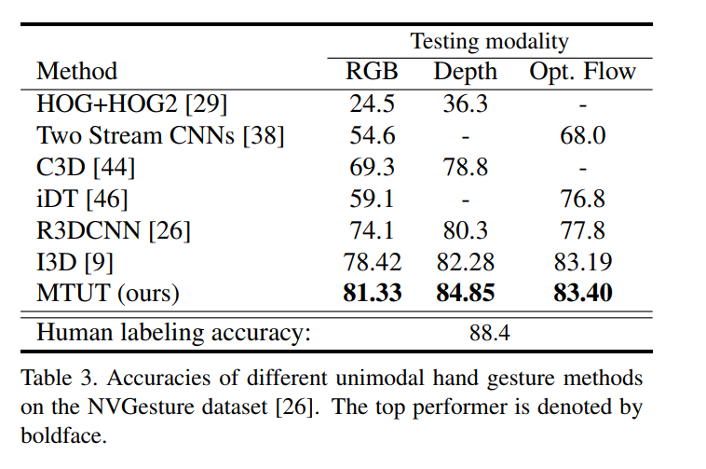
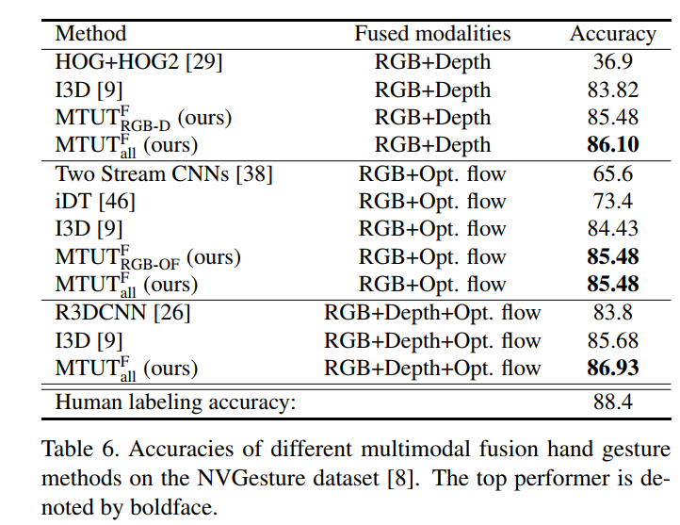
Improving the Performance of Unimodal Dynamic Hand-Gesture Recognition with Multimodal Training

Slide 13
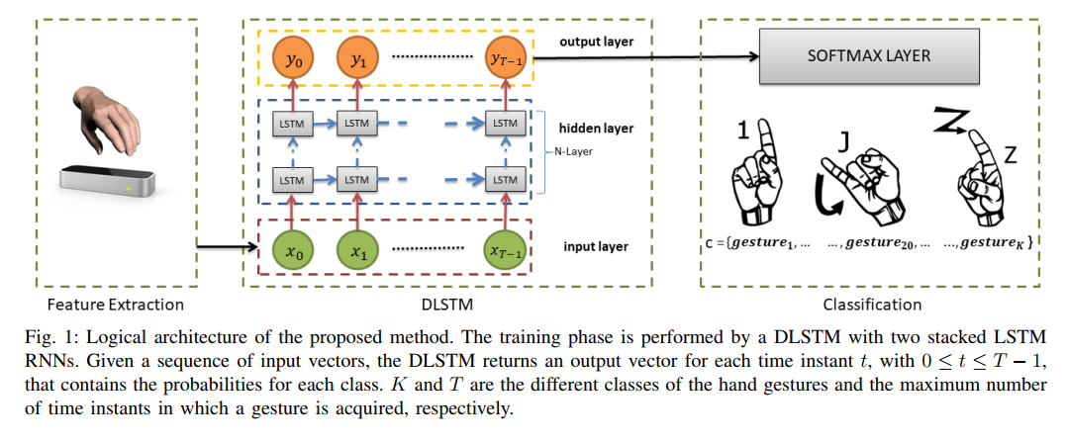
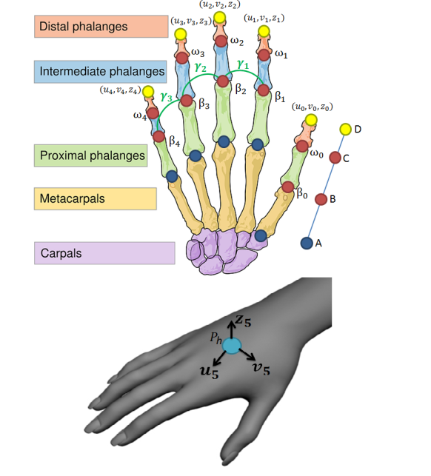
Exploiting Recurrent Neural Networks and Leap Motion Controller for Sign Language and Semaphoric Gesture Recognition

Slide 14
An Efficient PointLSTM for Point Clouds Based Gesture Recognition

Slide 15
Bonus
https://google.github.io/mediapipe/
https://github.com/TheJLifeX/mediapipe/blob/master/mediapipe/docs/hand_tracking_mobile_gpu.md

Slide 16
References
Materzynska, Joanna, et al. "The jester dataset: A large-scale video dataset of human gestures." Proceedings of the IEEE/CVF International Conference on Computer Vision Workshops. 2019.
Gupta, P. M. X. Y. S., and K. K. S. T. J. Kautz. "Online detection and classification of dynamic hand gestures with recurrent 3d convolutional neural networks." CVPR. Vol. 1. No. 2. 2016.
Zhang, Yifan, et al. "EgoGesture: A new dataset and benchmark for egocentric hand gesture recognition." IEEE Transactions on Multimedia 20.5 (2018): 1038-1050.
Abavisani, Mahdi, Hamid Reza Vaezi Joze, and Vishal M. Patel. "Improving the performance of unimodal dynamic hand-gesture recognition with multimodal training." Proceedings of the IEEE/CVF Conference on Computer Vision and Pattern Recognition. 2019.
Köpüklü, Okan, et al. "Real-time hand gesture detection and classification using convolutional neural networks." 2019 14th IEEE International Conference on Automatic Face & Gesture Recognition (FG 2019). IEEE, 2019.
Avola, Danilo, et al. "Exploiting recurrent neural networks and leap motion controller for the recognition of sign language and semaphoric hand gestures." IEEE Transactions on Multimedia 21.1 (2018): 234-245.
Guyon, Isabelle, et al. "The chalearn gesture dataset (cgd 2011)." Machine Vision and Applications 25.8 (2014): 1929-1951.

